Slide 1



Welcome to Our Home!
Let's learn about family and our house!

Slide 2

Meet Our Family!
Mom
Dad
Cooks and takes care of us
Helps and plays with us
Brother & Sister
Grandma & Grandpa
Our fun friends at home
Tell stories and hug us

Slide 3
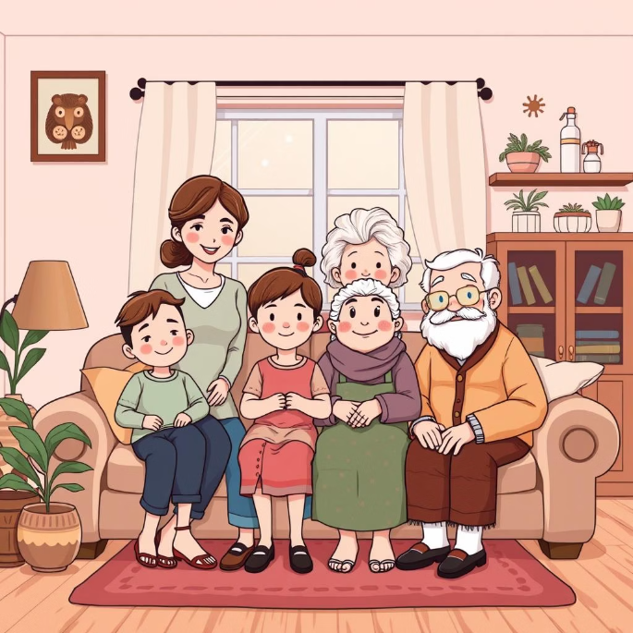
The Living Room
Couch
TV
Coffee Table
Lamps
We sit here and relax
Watch cartoons and movies
Place for snacks and books
Light up the room warmly

Slide 4

The Dining Room
Table
Chairs
Plates & Utensils
We eat meals together here
Everyone has a place to sit
Tools for eating yummy food

Slide 5





The Kitchen
Stove
Refrigerator
Sink
Counter
Where food gets cooked
Keeps food fresh and cold
We wash dishes and hands here
Space for food prep

Slide 6

The Bedroom
Bed
Where we sleep at night
Pillow & Blanket
Keep us comfy and warm
Closet
Stores our clothes neatly

Slide 7

The Bathroom
SINK
BATHTUB
MIRROR
TOILET

Slide 8





The Garden
Trees
Flowers
Grass
Swing
Provide shade and fresh air
Colorful and smell nice
Soft for playing and running
For fun and going up and down

Slide 9


THANKYOU

